Slide 1

Comprehensive Digital Marketing
Project Work Of AMUL

Slide 2
Part 1: Brand study, Competitor Analysis & Buyer’s/Audience’s Persona
Research Brand Identity: Study the brand's mission, values, vision, and unique selling propositions (USPs).
LOGO
Founder : TRIBHUVANDAS PATEL
Founded Year : 14 Dec, 1946
Official Website : https://www.amul.com

Slide 3

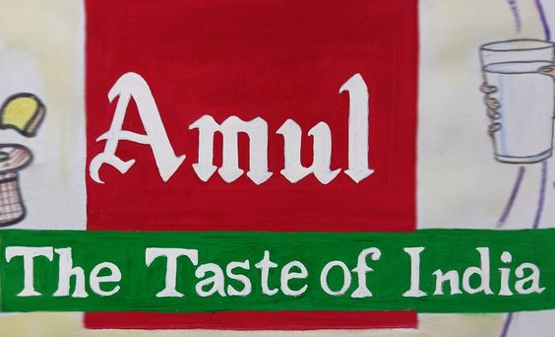
Mission/Values:Amul's mission is to provide consumers with high-quality dairy products while empowering farmers and ensuring sustainable growth. The brand aims to enhance the prosperity of its farmer members and fulfil the needs of its customers by offering nutritious and innovative dairy products.

Slide 4
Some of the core values that Amul upholds include:
Integrity: Amul is committed to conducting its business with honesty, transparency, and ethical practices, maintaining the trust of its stakeholders.
Customer Focus: The brand prioritizes understanding and meeting the needs of its customers, delivering products that meet their expectations.
Innovation: Amul constantly seeks to innovate and introduce new dairy products and processes, staying ahead in the market and catering to changing consumer demands.
Cooperative Spirit: As a cooperative organization, Amul believes in the power of collaboration and mutual support among farmers, members, and employees.
Social Responsibility: Amul is dedicated to social causes, supporting various initiatives that uplift farmers' lives and contribute to the welfare of society.
Vision: Amul's vision is to be a global leader in the dairy industry, recognized for its excellence in providing quality dairy products and contributing to the welfare of farmers.

Slide 5
Unique Selling Proposition (USP): Amul's unique selling proposition lies in its status as a cooperative brand owned and managed by millions of farmers. This distinctive structure gives it several key advantages:
Farmer Empowerment: By empowering farmers and ensuring a fair share of profits, Amul fosters a sense of ownership and dedication among its stakeholders.
Quality and Freshness: Amul is known for its commitment to providing high-quality dairy products, leveraging its cooperative network and stringent quality control measures.
Rich Product Portfolio: Amul offers a diverse range of dairy products, including milk, butter, cheese, ice cream, and more, catering to a wide spectrum of consumer preferences.
Competitive Pricing: Due to its cooperative nature and efficient supply chain, Amul can offer its products at competitive prices, making them accessible to a broader audience.
Brand Trust: Over the years, Amul has earned the trust of consumers through consistent quality, reliable supply, and its cooperative values, making it a beloved household brand in India and beyond.
It's important to note that the provided text is limited and may not cover all aspects of Amul's brand identity comprehensively. For a more in-depth analysis, further research on Amul's history, marketing strategies, and recent developments would be necessary.

Slide 6
Part 1: Brand study, Competitor Analysis & Buyer’s/Audience’s Persona
Analyze Brand Messaging: As an AI language model, I don't have access to real-time data or external sources beyond my last update in September 2021. Unfortunately, I cannot analyze the current brand messaging for Amul without specific information about its tagline.
Up until my last update, Amul is an Indian dairy cooperative society that is well-known for its dairy products, especially its butter and other milk-based products. Its tagline, "The Taste of India," has been widely recognized and associated with the brand for many years.
Examine The Brand Tagline; However, it's essential to note that brand messaging and taglines can change over time, so it's recommended to refer to the latest information from official sources or conduct a search to get up-to-date and accurate information about Amul's current tagline and brand messaging

Slide 7
Part 1: Brand study, Competitor Analysis & Buyer’s/Audience’s Persona
Competitor Analysis: Select three competitors operating in the same industry or niche as the chosen brand, examine their USPs and online communication.
Competitor 1: https://www.heritagefoods.in
Heritage Foods Limited (HFL), a flagship company of the Heritage Group, is a fast-moving consumer goods (FMCG) company. It is engaged in the dairy, retail, agri, bakery and renewable energy businesses. The company dairy products comprise butter milk, curd, flavored milk, lassi, ice-cream, milk, table butter, milk powder, panner, and also UHT milk.
Competitor 2: http://www.visakhadairy.com/
Sri Vijaya Visakha Milk Producers Company Limited (Visakha Dairy) was established in the year 1973 under Co-operative Societies Act and commissioned dairy plant at Akkireddipalem, Visakhapatnam with 50,000 LPD handling capacity in the year 1977.
Competitor 3: https://www.godrejjersey.com/
Jersey Dairy is located on the island of Jersey in the Channel Islands and is farmer owned. All our products are made from milk produced exclusively by the finest pure-breed Jersey cows, which can trace the purity of lineage back to 1763.

Slide 8
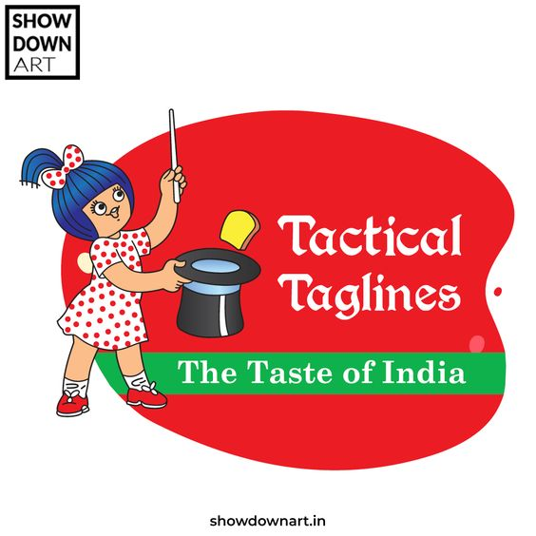
Website Design and User Experience: Assess the website layout, navigation, and overall user-friendliness.
Content Strategy: Evaluate the type of content they publish and how often (articles, videos, infographics, etc.).
Social Media Presence: Check their engagement levels, number of followers, and frequency of posts.
Brand Messaging: Analyze their tone, voice, and consistency in branding across different platforms.
Customer Interaction: Look for how they handle customer inquiries, complaints, and feedback.

Slide 9
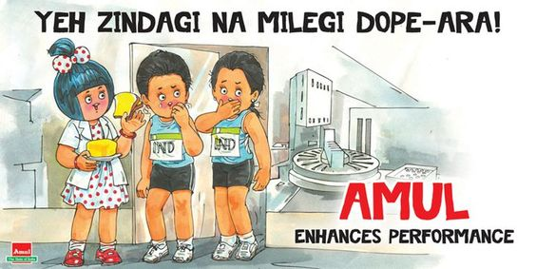
Strengths and Weaknesses: Based on the information gathered, identify the strengths and weaknesses of each competitor concerning their USPs and online communication strategy.
Opportunities and Threats: Assess the opportunities each competitor might be capitalizing on and potential threats they may face in the market.
Differentiation: Compare the chosen brand's USPs and online communication with those of its competitors. Identify areas where the brand stands out and where it can improve.
Remember that competitor analysis is an ongoing process, and it's crucial to keep track of any changes or developments in the market landscape. Conducting a thorough competitor analysis can provide valuable insights to help businesses refine their strategies and stay competitive in the market.

Slide 10
Part 1: Brand study, Competitor Analysis & Buyer’s/Audience’s Persona
Buyer's/Audience's Persona: Clearly define the target audience for the chosen brand. Consider demographics, psychographics, behaviors, and interests.
As an AI language model, I don't have access to external files or the internet, so I can't provide a PDF of Amul. However, I can help you define the target audience for the Amul brand based on the information available up to my last update in September 2021

Slide 11
Target Audience for Amul:
Demographics:
Age: Amul products have a broad appeal across various age groups, but their main focus is often on children, teenagers, and young adults.
Gender: Amul products cater to both males and females.
Location: The brand targets consumers across India, with a strong presence in both urban and rural areas.
Psychographics:
Cultural identity: Amul has a strong connection with Indian culture and heritage, appealing to individuals who embrace their Indian identity and value traditional products.
Value-oriented: Amul's products are known for their affordability and value for money, making them popular among price-conscious consumers.
Food enthusiasts: Amul targets individuals who appreciate high-quality dairy products and are willing to pay a premium for superior taste and nutrition

Slide 12
Behaviours:
Regular dairy consumers: Amul targets consumers who regularly consume dairy products such as milk, butter, cheese, and yogurt as part of their daily diet.
Brand loyalty: The brand enjoys a significant level of brand loyalty from consumers who have grown up with Amul products and continue to trust the brand's quality.
Health-conscious consumers: Amul also appeals to health-conscious individuals who seek nutritious dairy options for themselves and their families.
Interests:
Family-oriented: Amul's marketing often focuses on family values and portrays its products as a wholesome choice for the entire family.
Sports and fitness enthusiasts: Amul sponsors various sports events and campaigns, attracting consumers interested in sports and fitness.
Overall, the target audience for Amul is a diverse group of individuals who value quality, affordability, and their cultural roots while seeking nutritious and delicious dairy products for themselves and their families. Keep in mind that marketing strategies and target audience focus may evolve over time, so it's always essential to refer to the most recent data and market research for the most accurate audience profile.

Slide 13
Part 2: SEO & Keyword Research
SEO Audit: Now that you’ve learned how to show up in search results, let’s determine which strategic keywords to target in your website’s content, and how to craft that content to satisfy both users and search engines. The power of keyword research lies in better understanding your target market and how they are searching for your content, services, or products. In this chapter, you’ll get tools and strategies for uncovering that information, as well as learn tactics that’ll help you avoid keyword research foibles and build strong content. Once you uncover how your target audience is searching for your content, you begin to uncover a whole new world of strategic SEO!
Key word Research: Keyword research is a practice search engine optimization professionals used to find and research search terms that users enter into search engines when looking for products, services, or general information keywords are related to queries that are asked by users in search engines.
On Page optimization: refers to all measures taken by SEOs within the website to improve the ranking of a site in search engineer result pages. These measures are related to content and HTML source code of a page, e.g., meta tags, keyword Exc

Slide 14
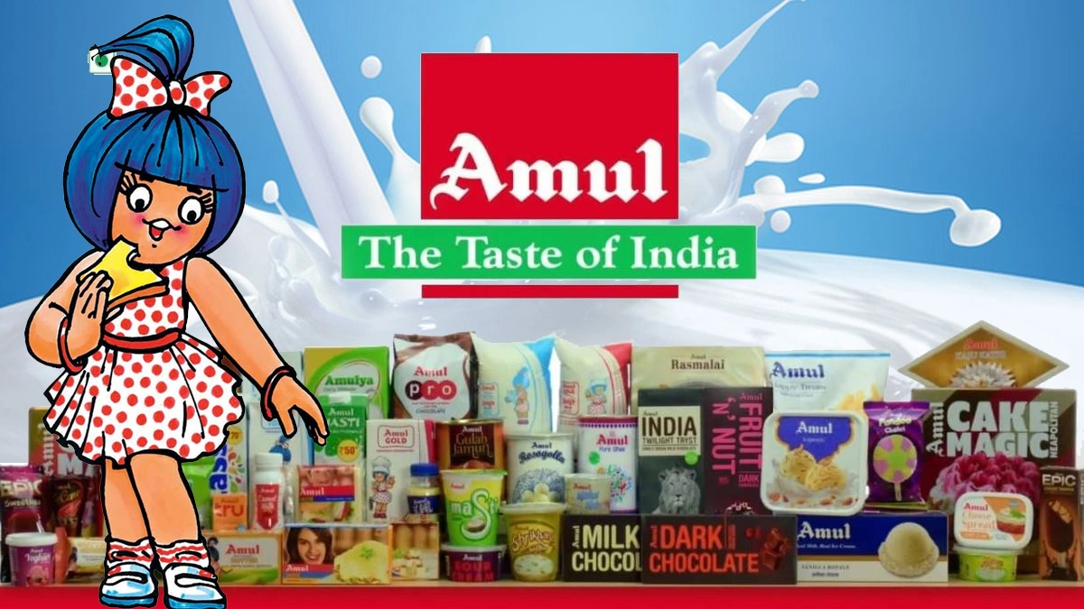
Amul : Amul is an Indian dairy cooperative, based at Anand in the state of Gujarat. Founded in 1946, the brand is today managed by the Gujarat Co-operative milk Marketing Federation Ltd (GCMMF) which is jointly owned by about 3million milk producers in the state. Amul the co-operative was formed as a response to the exploitation of marginal milk producers by agents and traders of the existing dairy in the state. The co-operative has gone from strength to strength on the back of inspired leadership of Tribhuvandas Patel, the founder Chairman and the Dr Verghese Kurien, who was entrusted the task of running the dairy from 1950. The amul model has helped india to emerge as the largest milk producer in the world. More than 15million milk producers contribute their milk in 144,500 dairy cooperative societies across the country. Their milk is processed in 184 district co-operative unions and marketed by 22 state marketing Federations, ensuring a better life for millions.

Slide 15
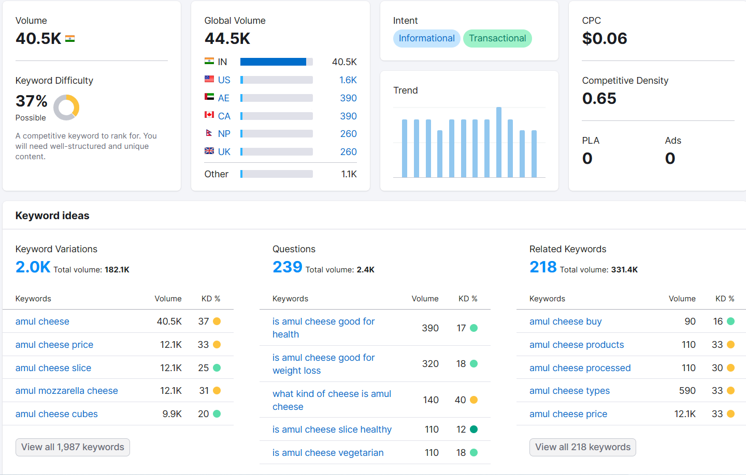
Key word Research :-

Slide 16
SL NO. | KEY WORD | INTENT | VOLUE | KD% | CPC | COM | SF | RESULT
1 | Amul | N | 135,000 | 76 | 0.11 | 0.02 | 7 | 99
2 | Amul Ice Cream | I | 90,500 | 30 | 0.07 | 0.27 | 7 | 94
3 | Amul Butter | IT | 60,500 | 34 | 0.07 | 0.67 | 5 | 96
4 | Amul Dark Chocolate | IT | 60,500 | 39 | 0.06 | 0.98 | 8 | 89
5 | Amul Milk | NT | 60,500 | 59 | 0.18 | 0.61 | 6 | 26.3M
6 | Amul cheese | IT | 40,500 | 37 | 0.06 | 0.65 | 8 | 92
7 | Amul Chocolate | TI | 40,500 | 41 | 0.06 | 0.97 | 9 | 13.5M
8 | Amul Ghee | C | 33,100 | 34 | 0.06 | 1.00 | 5 | 93
9 | Amul Milk Price | C | 33,100 | 45 | 0.16 | 0.40 | 6 | 100
10 | Amul Cream | IT | 27,100 | 37 | 0.04 | 0.63 | 6 | 19.9M
https://youtube.com/@shyamsathivelli4859 https://youtube.com/@shyamsathivelli4859

Slide 17
Part 3: Content Ideas and Marketing Strategies
Content Idea Generation & Strategy: Create a content calendar for the remaining month of July by brainstorming content themes, exploring various formats like blog posts, videos, infographics, podcasts, and interactive quizzes, and scheduling publication dates mainly on Facebook & Instagram. And include the strategy, aim and the idea behind these posts and story
Content Calendar Example (Try creating a table for the month of July)

Slide 18
Content Idea Generation & Strategy: Strategy and Aim:
Engagement & Fun: The content calendar starts with an infographic on Ice Cream Day to engage followers playfully, encouraging them to interact by sharing their flavours
Brand Storytelling: The video on July 5th shares Amul's heritage, creating an emotional connection with the brand and fostering loyalty.
Education & Awareness: The blog post on July 10th aims to educate the audience about dairy farming, showcasing Amul's commitment to sustainability.
CSR & Impact: The podcast on July 15th highlights Amul's corporate social responsibility initiatives, enhancing the brand's positive image.
User-Generated Content: The interactive quiz on July 20th generates user participation, building a sense of community around the brand.
Product Showcase: The behind-the-scenes video on July 25th showcases the quality and craftsmanship behind Amul Butter.
Healthy Living: The infographic on July 30th provides health tips, positioning Amul products as part of a wholesome lifestyle.

Slide 19
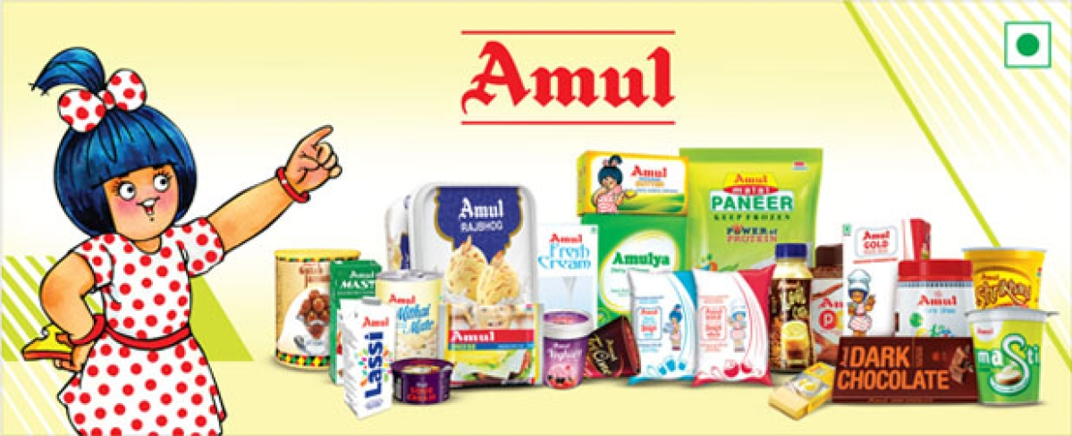

Idea Behind Amul's Content:
Amul has a rich history and a deep connection with its consumers. The content calendar aims to leverage this by celebrating the brand's legacy, educating the audience about its values and initiatives, and engaging them through interactive content. By showcasing transparency, social responsibility, and product quality, Amul can further solidify its position as a trusted and beloved dairy brand in the hearts of its audience.

Slide 20
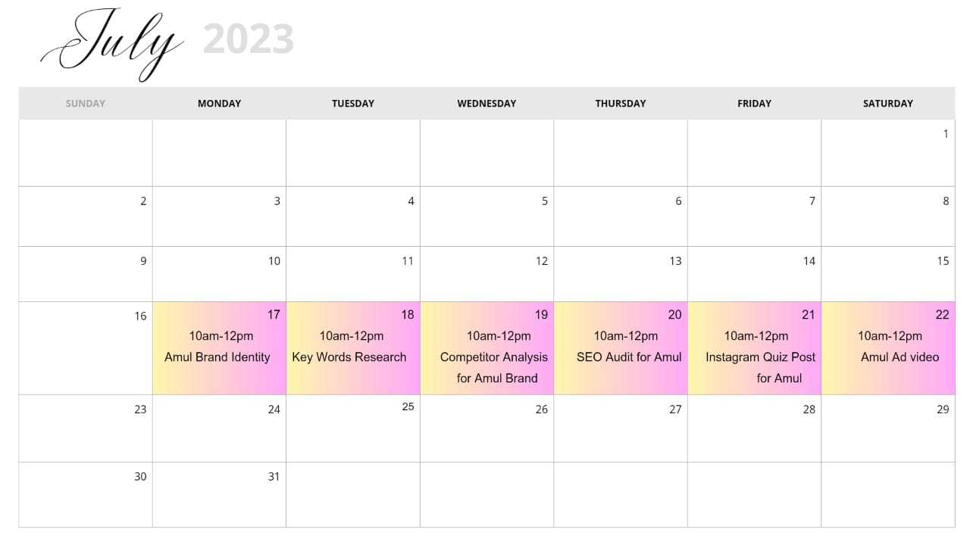

Slide 21
Part 3: Content Ideas and Marketing Strategies
Reflect on the content ideas and marketing strategies process, discussing the challenges encountered and lessons learned.
Which strategy does Amul use
Amul has usen a low - cost pricing strategy forproducts that r consumed regularly. This pricingstrategy of amul made it affordable for its targetaudience. Increasing the price of goods proportional to their audiences increase in incomehelped them retain their customer base,
How did amul become successfulIn 1960, amul was the 1st brand in the world touse buffalo milk to produce skimmedmilk powder .in additional with its three-tiercooperative structure , amul has transformed from traditional operations to a more profitable and efficient structure
AMUL MARKETINGSTRATEGIES
What is the aim of amul : -
It's main aim is to provide remunerative returns tothe farmers & also serve the intrest of theconsumers by providing quality products Which rSY good value for money
Objectives of amul:
Providing assured & remunerative market for all the milk produced by the farmer members & also to provide good quality milk products

Slide 22
Part 4: Content Creation and Curation (Post creations, Designs/Video Editing, Ad Campaigns over Social Media and Email Ideation and Creation)
Post Creation:
Select Content Categories: Identify three different content formats relevant to the chosen topic or industry. Research and Brainstorm: Research trending topics, industry news, or audience interests within each category. Brainstorm ideas for social media posts that align with each category. Do note that 1 content format has to be video and additionally 3 stories/status are to be created.
Format 1 : BLOG ARTICLE
AIM : Boost SEO & provide information about a certain new product
DATE : Amul has launched sports drink and this blog will cover the details about products of amul.
TOPIC : Benefits of drinking the sports drinks

Slide 23
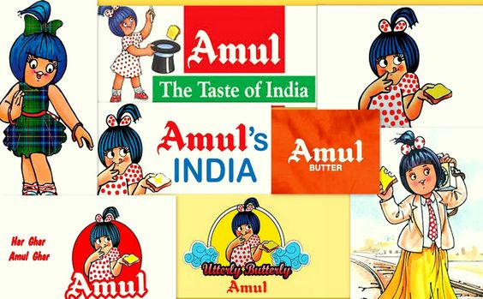
Format 2 : Video
AIM :To promote newly launched sports drink
DATE : 20-07-2023
IDEA : Amul has launched new sports drink and we make a video on the benefits of the orange drink.
TOPIC : Benefits of energy drink
Format 3 : Creative
AIM : Brand awareness & reach
DATE : 20-07-2023
IDEA : To create a story on the amul product in different social media platforms
TOPIC : AMUL ad

Slide 24
Part 4: Content Creation and Curation (Post creations, Designs/Video Editing, Ad Campaigns over Social Media and Email Ideation and Creation)
Instagram Story
Utilize the Stories feature on Instagram for three consecutive days. Share behind-the-scenes glimpses, polls, quizzes, or sneak peeks etc to encourage audience participation. Once uploaded use the story highlight feature on Instagram and save the 3 story with an appropriate name for each. Note: Once done monitor the performance of the posts and Stories using the insight tool and analyze the engagement metrics (likes, comments, shares, impressions, etc.). Based on the analysis, mention the strategies and areas for improvement.

Slide 25
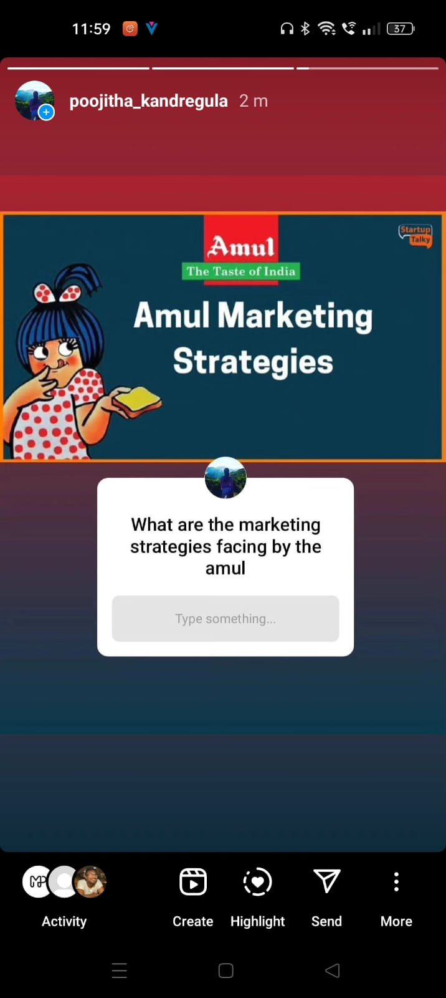
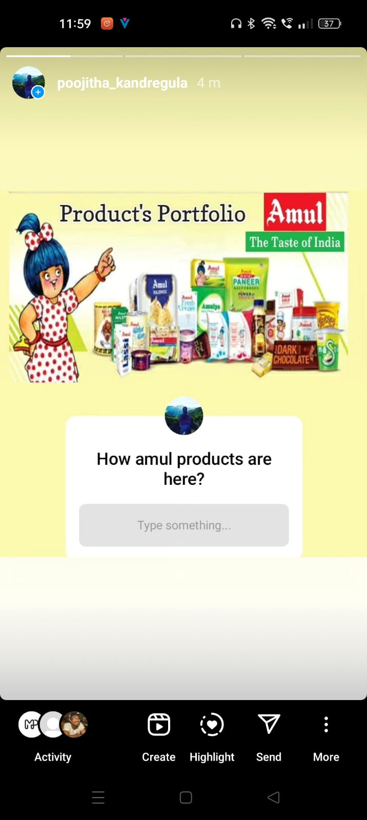
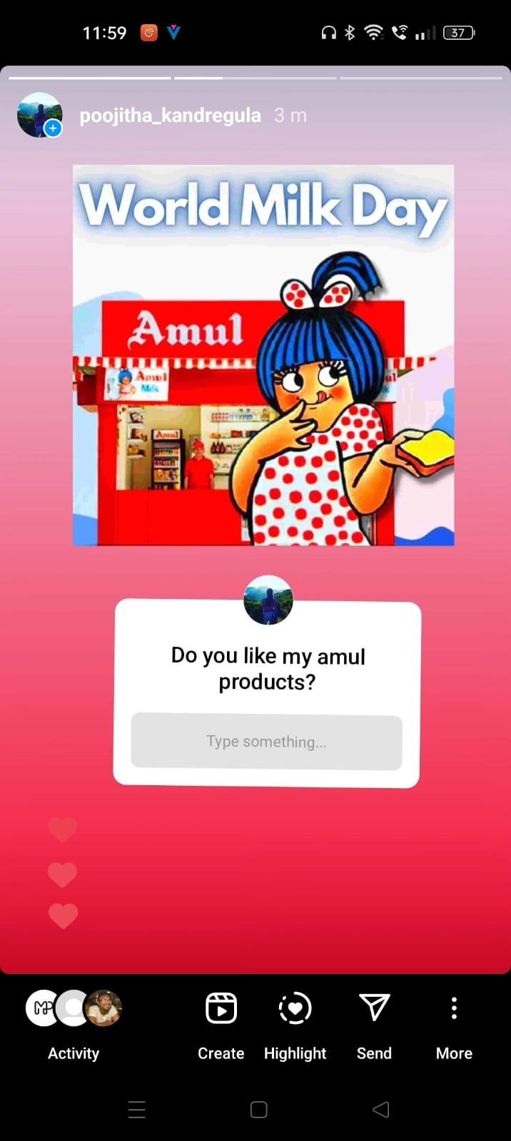
Instagram Story

Slide 26
Part 4: Content Creation and Curation (Post creations, Designs/Video Editing, Ad Campaigns over Social Media and Email Ideation and Creation)
Designs/Video Editing
Design Tools Familiarization (use Canva for creating visually appealing graphics)
Video Creation: Utilize VN or any video editor of your choice to create videos related to the chosen topic.
Amul is an acronym of the Indian cooperative society named Gujarat Milk Marketing Federation based in Anand, Gujarat. It is under the ownership of Gujarat Cooperative Milk Marketing Federation Limited, Department of Cooperation, Government of Gujarat. It is controlled by 3.6 million milk producer
AMUL AD VIDEO LINK
https://youtu.be/14zSpQui__8
By Using Canva, & other video editing apps are used to develop the video for the AMUL AD.
And uploaded in different platforms to reach them.

Slide 27

VIDEO

Slide 28

MAKING THE VIDEO FOR AMUL AD
The video production process consists of 3 main steps: pre-production, which is the planning stage for mapping out your strategy and script for the video, production is the phase in which the video is shot, and finally post-production, which involves editing the video, adding music and other effects. Let’s walk through the process step by step.
*Firstly collect information about AMUL through official websites of Amul
*Secondly collect images and other details about them and ready to plan the process
*Thirdly from the collected data ,make the video by using different editing apps, sites

Slide 29
Part 4: Content Creation and Curation (Post creations, Designs/Video Editing, Ad Campaigns over Social Media and Email Ideation and Creation)
Social Media Ad Campaigns
Ad Campaigns over Social Media:
Come up with 3 ad campaigns each covering one of the mentioned goals: brand awareness, driving website traffic, or generating leads
https://pin.it/F0CgnNO
https://www.instagram.com/p/Cu8z743L_S0/?igshid=MzRlODBiNWFlZA==
https://www.instagram.com/p/Cu8zX0Srv3a/?igshid=MzRlODBiNWFlZA==
https://www.instagram.com/p/Cu8zyyIrnl5/?igshid=MzRlODBiNWFlZA==

Slide 30
Part 4: Content Creation and Curation (Post creations, Designs/Video Editing, Ad Campaigns over Social Media and Email Ideation and Creation)
For every campaign clearly define:
Advertising Goals: increasing brand awareness, driving website traffic, or generating leads.
Audience Targeting: Define the target audience for the ad campaigns based on demographics, interests, and behavior.
Ad Creation: Create visually appealing ad creatives, compelling ad copy and relevant call-to-action.

Slide 31
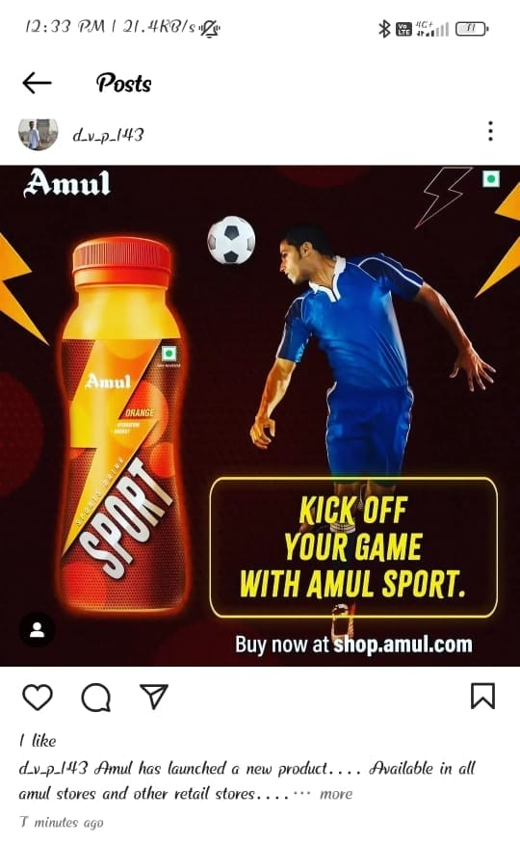
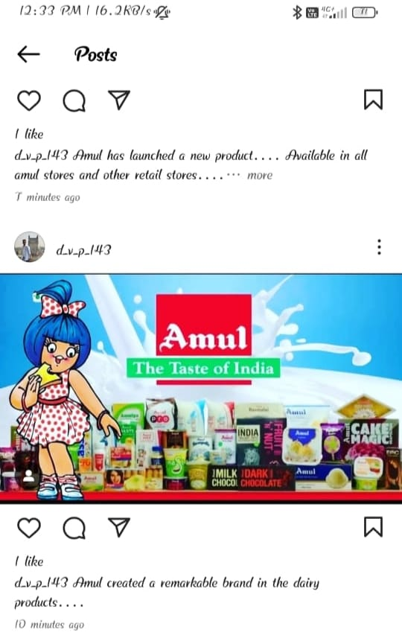
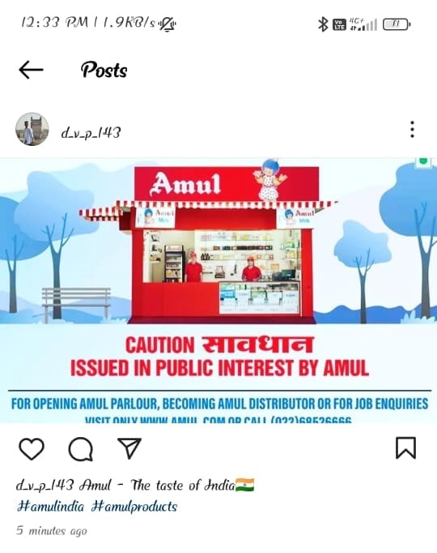
By creating amazing strategies that could touch every Indian’s heart, Amul made its way towards success. Subtle placements of ‘‘Amul Girl’ with current affairs and then posting the same on every social media platforms, Amul was able to create its strong presence in the minds of the customers.

Slide 32
Part 4: Content Creation and Curation (Post creations, Designs/Video Editing, Ad Campaigns over Social Media and Email Ideation and Creation)
Email Ad Campaigns
Ad Campaigns for email marketing:
Come up with 2 email ad campaigns with the mentioned goals: brand awareness & generating leads

Slide 33
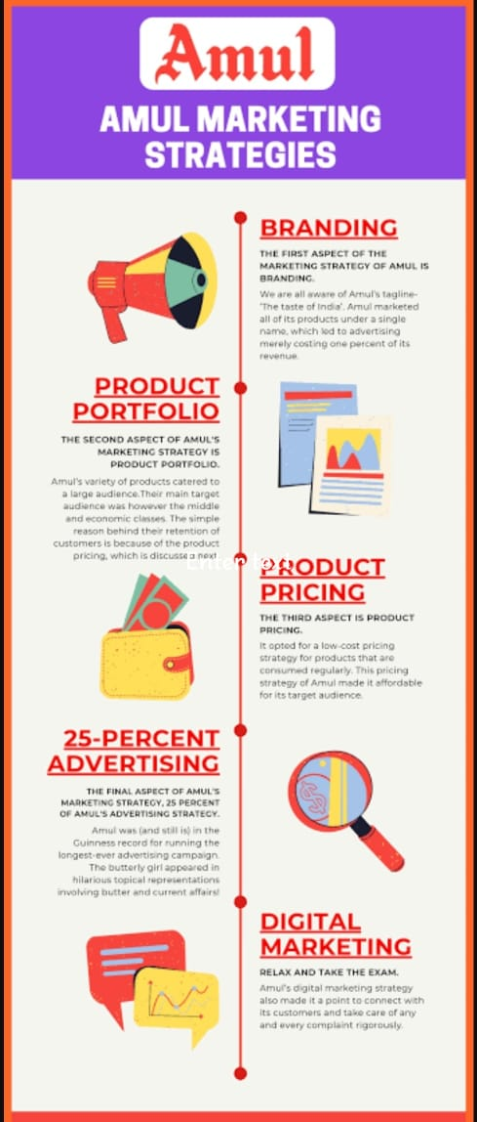
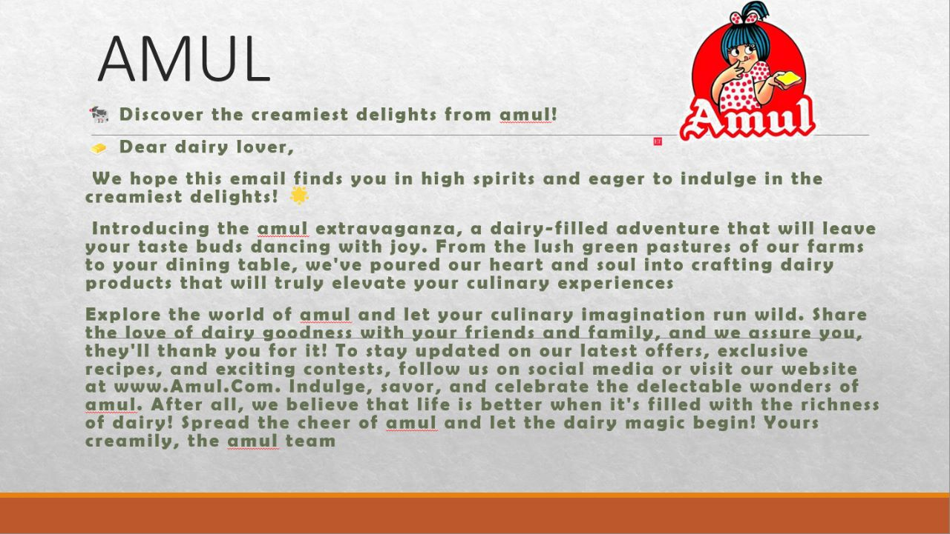
Email Ad Campaign 1 - Brand Awareness
(insert emailer image)
https://youtu.be/p9jzAGoaFM8
BY: Vihari & Pravallika

Slide 34
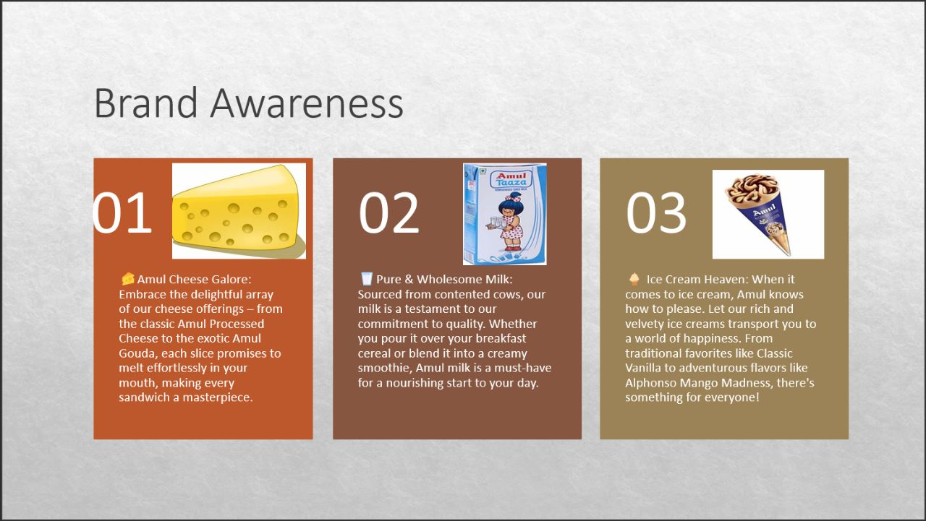

Slide 35
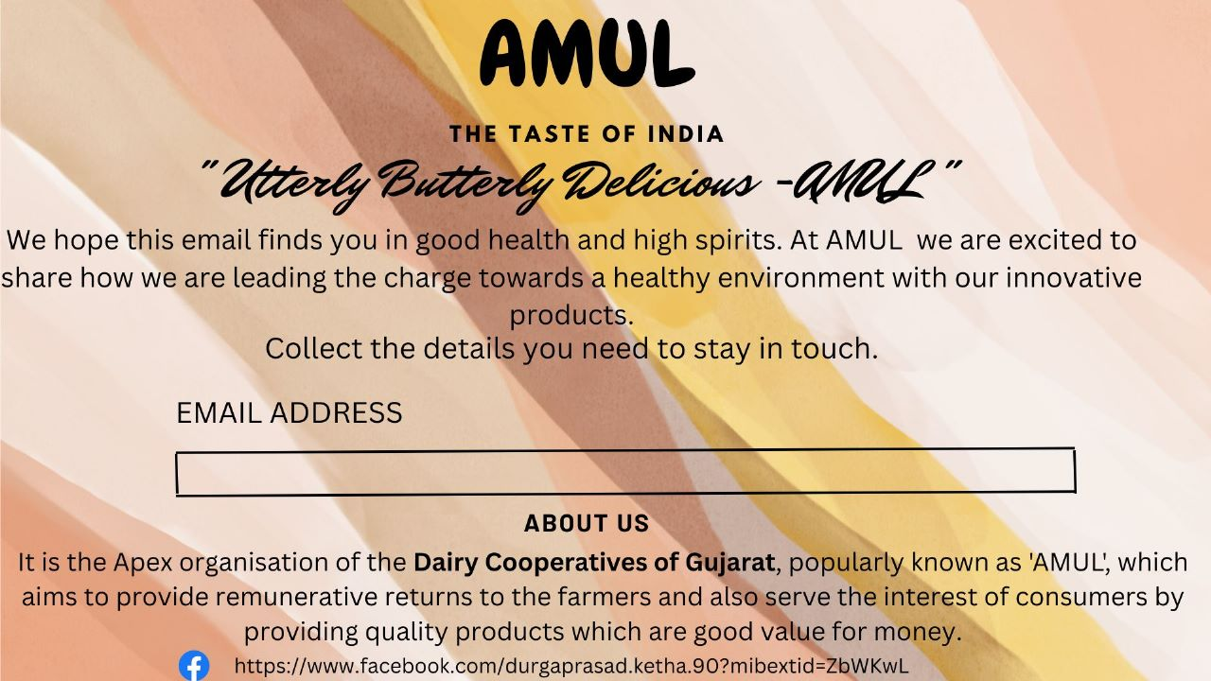
Email Ad Campaign 2 - Lead Generation
(insert emailer image)
https://youtu.be/2EOmnocmIbY

Slide 36
Part 4: Content Creation and Curation (Post creations, Designs/Video
Editing, Ad Campaigns over Social Media and Email Ideation and Creation)
Reflect on the content creation and curation process, discussing the challenges faced and lessons learned.
We learnt how to create ad campaigns and video designing and gained practical knowledge in digital marketing.
We gradually learnt how to gain loyal customers and build brand image by attracting target audience.
We convey our sincere regards to our project mentors, tutors & our college staff for their guidance throughout the project.

